Slide 1

Bipin Tripathi Kumaon Institute Of Technology
E-Fitness Tracker
Presented by
Guided by
Jatin Gusain (200180101030)
Prashant Devshali (200180101040)
Priyanshu Sharma(200180101043)
Shubham Singh Khati (200180101052)
Dr. Kapil Chaudhary
Submitted for the partial fulfillment
of
Bachelor Of Technology
in
Computer Science And Engineering

Slide 2
Content
1. Introduction
2. Problem Statement
3. Abstract
4. Background
5. Scope of the Project
6. Methodology
7. System Architecture
8. Real-time Feedback
9. Future Enhancements
10. Results and Discussion
11. Conclusion
12. References
2

Slide 3

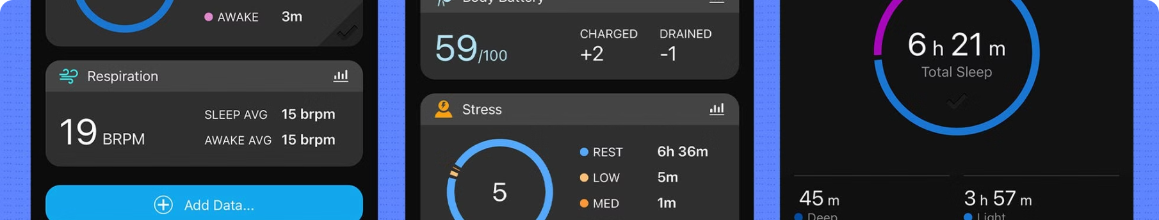
Project Overview
This project aims to develop an innovative AI-powered fitness trainer that utilizes pose estimation technology to provide real-time feedback and guidance during various exercises. The goal is to empower fitness enthusiasts, athletes, and individuals of all fitness levels with personalized exercise analysis and coaching, ultimately enhancing their workout experience and reducing the risk of injury due to improper form.

Slide 4
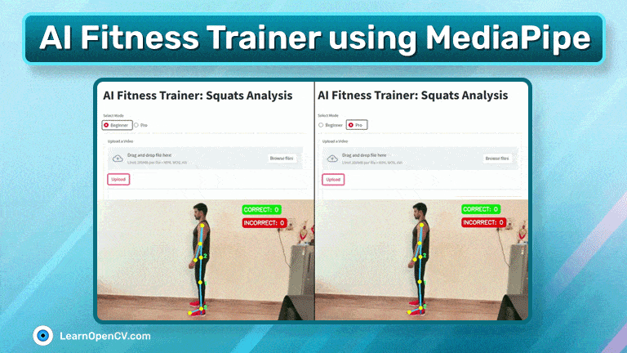

Slide 5

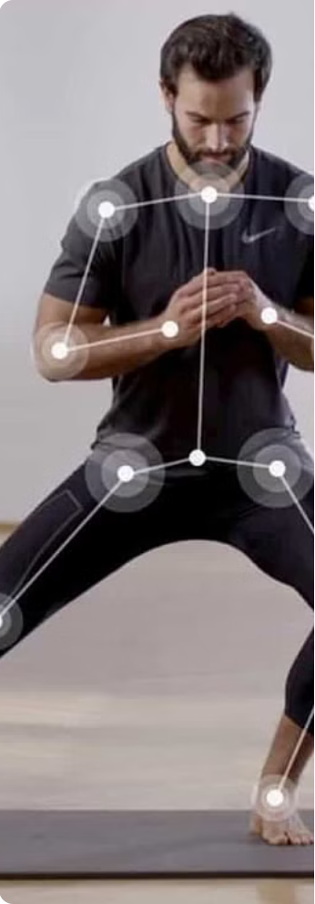
Problem Statement
Accurately assessing exercise form and providing personalized feedback during workouts can be a significant challenge for fitness enthusiasts. Traditional methods often rely on in-person coaching or subjective visual assessments, which can be limited in their ability to provide immediate and detailed feedback. The AI Fitness Trainer project seeks to address these challenges by leveraging the power of pose estimation technology to analyze exercise form and deliver real-time guidance to users.
1
Difficulty in Assessing Exercise Form
2
Lack of Personalized, Real-time Feedback
Accurately evaluating exercise form can be challenging, especially for individuals without extensive fitness expertise.
Traditional fitness methods often fail to provide immediate, tailored feedback during workouts, improve their technique.
3
Potential Risks of Injury
Improper exercise techniques can lead to increased risk of injury, undermining the user's fitness progress and overall well-being.

Slide 6
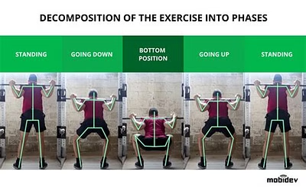
Abstract
Regular exercise is essential for physical health, but many individuals struggle with proper form and technique, leading to suboptimal results and increased injury risks. The AI Fitness Trainer project aims to address these challenges by leveraging pose estimation technology to provide real-time guidance and feedback during workout sessions.
This project focuses on analyzing fundamental exercises, using MediaPipe's Pose solution. By capturing key body landmarks and angles from a camera feed, the system can assess exercise form and provide immediate feedback to users.

Slide 7
Background
The fitness training landscape has undergone a significant transformation, with the integration of technology-driven approaches gaining attraction. The rise of AI and pose estimation techniques has opened new possibilities for enhancing exercise analysis and coaching. By leveraging these advancements, the AI Fitness Trainer aims to provide a more personalized and effective fitness experience compared to traditional methods.
Traditional Fitness Methods
Technology-driven Approaches
Reliance on in-person training, subjective visual assessments, and limited feedback. Potential for inconsistent guidance and difficulty in tracking progress.
Incorporation of AI, pose estimation, and real-time feedback. Ability to provide personalized, data-driven coaching and track progress more effectively.

Slide 8
Project Scope
The AI Fitness Trainer project is designed to cater to a diverse audience, including fitness enthusiasts, athletes, and individuals of all fitness levels. The primary objectives of this project are to develop an AI-powered fitness trainer that can accurately analyze crunch exercises, provide real-time feedback on form and technique, and ultimately enhance the overall exercise experience for users.
Target Audience
Project Objectives
Fitness enthusiasts, athletes, and individuals of all fitness levels who seek personalized guidance and real-time feedback during their workouts.
Develop an AI-powered fitness trainer using pose estimation technology. Analyze crunch exercises for form assessment and provide immediate feedback to users.

Slide 9
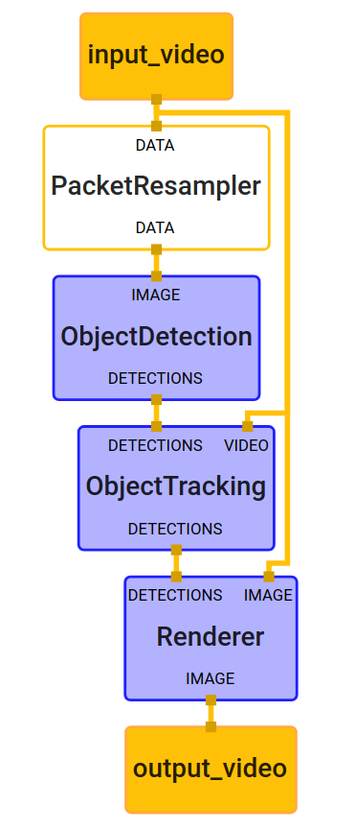
Methodology
The AI Fitness Trainer project leverages a robust technology stack, including frameworks and libraries such as MediaPipe, OpenCV, and Numpy, to enable accurate pose estimation and exercise recognition. By capturing camera feed or video recordings, the system extracts and analyzes key landmarks from the user's body.
1
Data Collection
Capture camera feed or video recordings of users performing exercises such as crunches, squats etc. Extract and analyze pose landmarks to gather data for training and evaluation.
2
Pose Detection
Utilize pose estimation techniques to detect and track the user's body landmarks during the exercise, providing the foundation for exercise recognition.
3
Exercise Recognition
Develop algorithms and machine learning models to recognize the specific sequence of movements associated with exercises, enabling form assessment and feedback.
4
Integration with Pose Estimation
Heuristic rules and decision trees can enhance pose estimation outputs for exercise recognition. This integration, along with machine learning models or sequence matching algorithms, accurately identifies exercises using real-time pose data from videos or camera feeds.

Slide 10

Tools and Technologies Use
Utilize MediaPipe - a cutting-edge open-source framework for building multimodal machine learning pipelines, enabling robust and accurate pose estimation.
Leverage OpenCV - a powerful computer vision library that facilitates real-time video processing and analysis essential for exercise recognition.
Incorporate NumPy - a scientific computing library that provides efficient numerical operations, aiding in the processing and manipulation of pose data.

Slide 11
Exercise Recognition
The core of the AI Fitness Trainer's functionality lies in its ability to accurately recognize and analyze the user’s exercises. By leveraging pose estimation data, the system employs a combination of pose templates and sequence matching techniques to detect and evaluate the execution of crunch exercises. This approach allows for real-time feedback and guidance, helping users maintain proper form and technique throughout their workout.
Pose Templates
Sequence Matching
Machine Learning Models
The system utilizes pre-defined pose templates to identify the key body positions and movements associated with crunch exercises, enabling accurate recognition.
By analyzing the sequence of pose landmarks during the exercise, the system can match the user's movements to the expected crunch exercise patterns, powering the form assessment capabilities.
Advanced machine learning classifiers or rule-based systems can be employed to further enhance the accuracy and robustness of the exercise recognition algorithms.

Slide 12
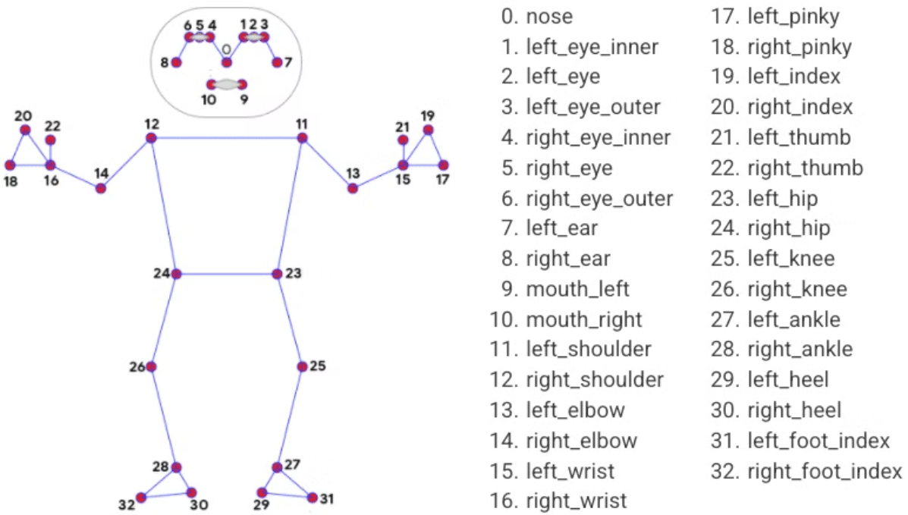
Key Body Landmarks

Slide 13



System Architecture
The AI Fitness Trainer's system architecture seamlessly integrates the pose estimation module with the exercise recognition capabilities. This integration allows for the real-time analysis of user movements, enabling immediate feedback and guidance during exercise. The architecture diagram showcases the flow of data and the interaction between the key components of the system.
Pose Estimation
Exercise Recognition
Real-time Feedback
The pose estimation module captures and analyzes the user's body landmarks, providing the necessary data for exercise recognition.
The exercise recognition algorithms process the pose data to detect and evaluate the user's exercise performance, triggering the feedback mechanisms.
The system delivers immediate feedback and guidance to the user, empowering them to make adjustments and optimize their exercise technique.

Slide 14
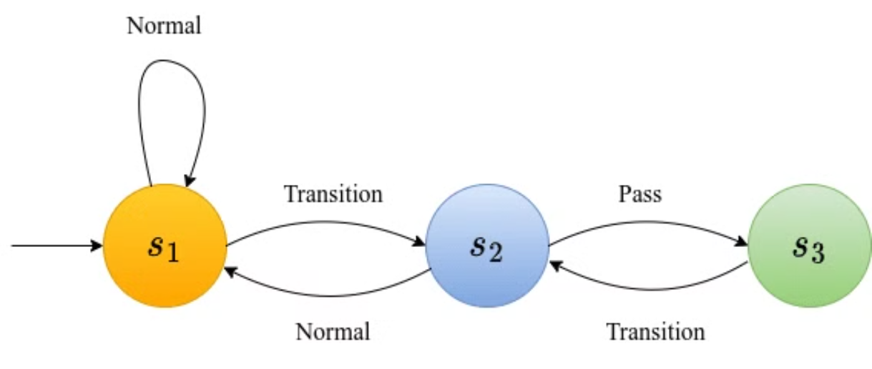
Transition Diagram

Slide 15
Future Enhancements
Integrate additional pose recognition models to detect a wider range of exercises, such as push-ups, lunges, and planks, expanding the AI Fitness Trainer's functionality beyond a single exercise.
Implement real-time feedback systems, using visual cues overlaid on the camera feed to guide users on proper form, posture adjustments, and ideal movement patterns during their exercises.
Introduce user profiles and personalization capabilities, leveraging machine learning techniques to tailor feedback, recommendations, and workout plans based on each user's goals, fitness level, and historical data.
Develop a mobile app companion that allows users to access workout history, set goals, receive notifications, and interact with the AI Fitness Trainer remotely, enabling a more comprehensive and accessible user experience.

Slide 16
Results and Discussion
The AI Fitness Trainer successfully demonstrated real-time squat analysis using pose estimation technology. By leveraging MediaPipe's Pose solution and OpenCV, the application accurately tracked key body landmarks to analyze various exercises’s performance. The results revealed:
Squat Counting Accuracy: The system reliably counted squats based on knee and hip angles, accurately distinguishing between proper and improper form.
Real-time Feedback: Users received instant feedback on their squat form through heuristic rules, highlighting areas for improvement such as knee alignment and hip positioning.
Performance Metrics: The application captured exercise metrics including repetition counts, form consistency, and exercise duration, providing valuable insights for users to monitor progress.
The discussion highlighted the system's effectiveness in guiding users through squats, showcasing the potential of AI-powered fitness trainers in promoting correct exercise techniques and enhancing workout experiences. Future iterations will explore additional exercises.

Slide 17
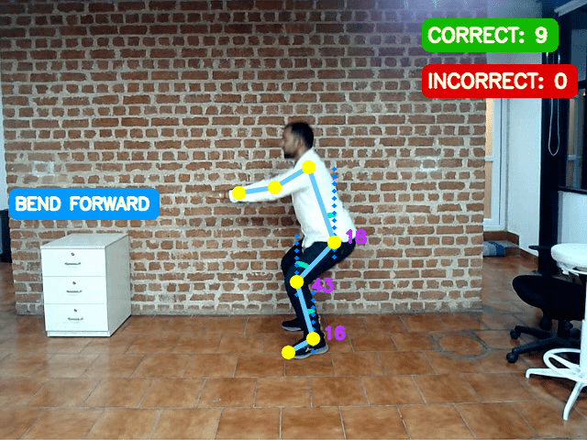
Conclusion
The AI Fitness Trainer project showcases the immense potential of leveraging pose estimation technology to enhance the fitness training experience. By providing real-time feedback and personalized guidance during crunch exercises, this innovative solution empowers users to improve their form, reduce the risk of injury, and achieve their fitness goals more effectively. Through the integration of advanced algorithms and user-friendly interfaces, the AI Fitness Trainer represents a significant step forward in the evolution of technology-driven fitness solutions, paving the way for a future where personalized exercise coaching is readily available to individuals of all fitness levels.

Slide 18
References
[1] Rahul, M. (2018) Review on Motion Capture Technology. Global Journal of Computer Science and Technology, 18, 1-F. https://typeset.io/papers/review-on-motion-capture-technology-3nao8jb6kv
[2] Kim, J., Campbell, A.S., de Ávila, B.E.F., et al. (2019) Wearable Biosensors for Healthcare Monitoring. Nature Biotechnology, 37, 389-406. https://www.nature.com/articles/s41587-019-0045-y
[3] González, L., Álvarez, J.C., López, A.M and Diego, Á. (2021) Metrological Evaluation of Human-Robot Collaborative Environments Based on Optical Motion Capture Systems. Sensors, 21, 3748. https://doi.org/10.3390/s21113748
[4] Xiao, W.H. (2017) Research on Label-Free Surgical Navigation Technology Based on Structural Light. Master’s Thesis, South China University of Technology.
[5] Nguyen, H.C., Nguyen, T.H., Scherer, R. and Le, V.H. (2022) Unified End-to-End YOLOv5-HR-TCM Framework for Automatic 2D/3D Human Pose Estimation for Real-Time Applications. Sensors, 22, 5419. https://www.mdpi.com/1424-8220/22/14/5419/xml
[6] Liu, Y.X. (2021) 2D Human Pose Estimation Based on Self-Distillation. Master’s Thesis, University of ESTC. https://kns.cnki.net/KCMS/detail/detail.aspx?dbname=CMFD202201&filename=10 21748638.nh https://ieeexplore.ieee.org/document/8765346
18

Slide 19


